Slide 1
Notes:
Thank mike
Disclaimer: My goal here is hopefully to add value.
Please be gentle, it’s my first time.

Slide 2
What’s with people liking JavaScript?

Slide 3
Well…
Notes:
I’m on of those people
Never thought I would be.

Slide 4
JavaScript is pretty awesome!!!
Notes:
Your response might be something like

Slide 5

Notes:
Why? I felt the same

Slide 6

Douglas Crockford
Notes:
I started listing to this guy.
Before that I was like

Slide 7
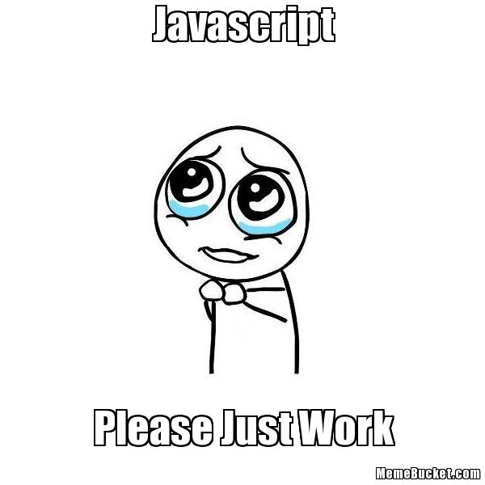
Notes:
Zk
Crockfor wrote a book

Slide 8
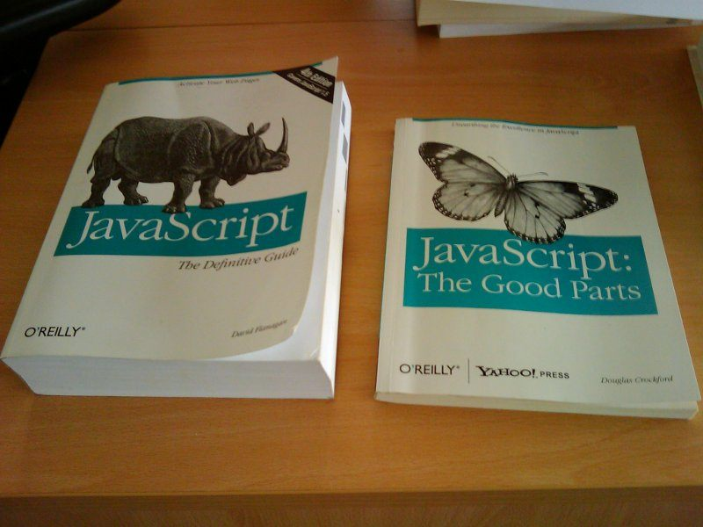
Notes:
Huge Contrast
He created a Linting tool to tell you about errors in your code
Javascript is interpreted, not compiled and it’s not type safe.

Slide 9
But I can seriously say…

Slide 10
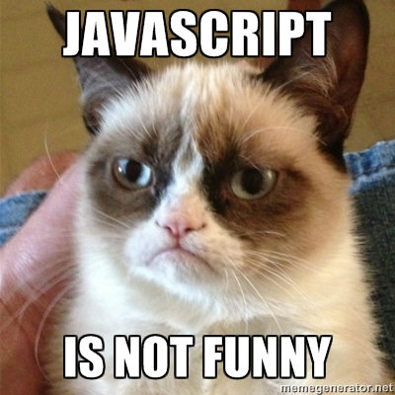

Slide 11

Brendan Eich
Notes:
Bredan Eich

Slide 12
Is making my mind feel like …

Slide 13

Notes:
Most of the time

Slide 14
So what’s the story…

Slide 15

Notes:
Trapped waiting for a prince

Slide 16

Notes:
In the browser wars

Slide 17
The other browser fought valiantly

Slide 18
Everybody start paying attention to standards

Slide 19
On December 3, 2009, ECMA-262 5th edition was published
Notes:
- Trailing commas are ok
No reserved words for property names-
NaN, Infinity, undefined : are all constants- parseInt() defaults to radix 10
/regexp/ produces new reg ex object every time- JSON.parse(), JSON.stringify()
Function.prototype.bind
String.prototype.trim
Array.prototype.every, filter, forEach, indexOf, lastIndexOf, map, reduce, reduceRight, some,
Date.now()
Date.prototype.toISOString
new Date(string) and Date.parse(string) will try ISO format 1st
Array.isArray()
Object.keys()
Object.create()
Object.defineProperty
Object.defineProperties
Object.getOwnPropertyDescriptor()
Object.getOwnPropertyNames(obj)
Object.getPrototypeOf(obj)
Object.seal(),
Object.freeze(),
Object.preventExtensions()
Object.isSealed()
Object.isFrozen()
Object.isExtensible()
Property attributes: writeable, value, enumerable, configurable, get, set
'use strict';- Strict Mode: No more implied global variables within functions. this is not bound to the global object by function form. apply and call do not default to the global object. No with statement. Setting a writeable: false property will throw. Deleting a configurable: false property will throw. Restrictions on eval. eval and arguments are reserved. arguments not linked to parameters. No more arguments.caller or arguments.callee. No more octal literals. Duplicate names in an object literal or function parameters are a syntax error

Slide 20

ES 6 Harmony
Notes:
Which means everybody is friends again. Google, facebook, mozilla, and Microsoft are working together to make javascript better
This started with the es 5 realease.

Slide 21

Notes:
Post mortem: Cause of death. No constraints in implementation lead to medical complications

Slide 22
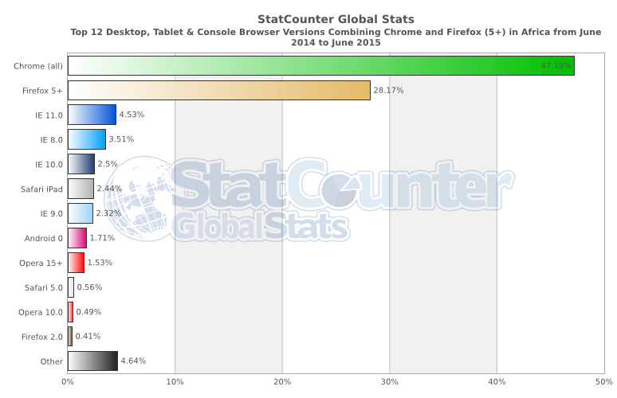

Slide 23
Now we are entering a new era…

Slide 24

Enter a new era. This is JavaScript!!
This is JavaScript!

Slide 25

New feature every year

Slide 26
Why JavaScript? Well ECMAScript
Notes:
But first
Actual official name is Ecmascript
Why didn’t it just die.
3 possible reasons.

Slide 27

All the browsers support it
Notes:
At the explosion of the web, it was the only language.

Slide 28
It got function right
Notes:
Isolation of concern
Really simple asynchronous programming

Slide 29
Almost never blocking, without using multiple threads because of the event loop
Notes:
Well sort off

Slide 30
The fruit ES6 or ES2015
Modules
Promises
Classes
Cleaner Lambda Expressions Syntax
Iterator, so that you can loop through collections
Generators
New data-structure objects, map + set
String Literals
De-structuring Assignment
First class representation of a promise
Blocked scope variables
Notes:
Lambda expressions has always been available in javascript

Slide 31
What’s next? ES 2016 and beyond
Async Functions
Array Comprehension
Opt in SharedState for webworkers and Atomic operations
Opt in type safety, extenstion TypeScript

Slide 32
Things I never new
Web workers are already available in the browser
Javascript can run Server Side. NodeJs the most common vm.
Isomorphic Javascript is the term used for javascript that can run in the browser and serverside
Build tools: Grunt, Gulp, Webpack npm
Package managers: Npm, bower, jspm
Project Scaffolding with Yeoman (Think of it as interactive Maven archetypes)
There are dependency injection frameworks for JavaScript the way you get Spring for Java. AngularJS for example provides one.
No need for server side apps in some situations. You get noSql databases like Couchdb that is fully rest enabled. So you can query data directly
Notes:
* Functions are first class citizen so lambda expression have always been there

Slide 33
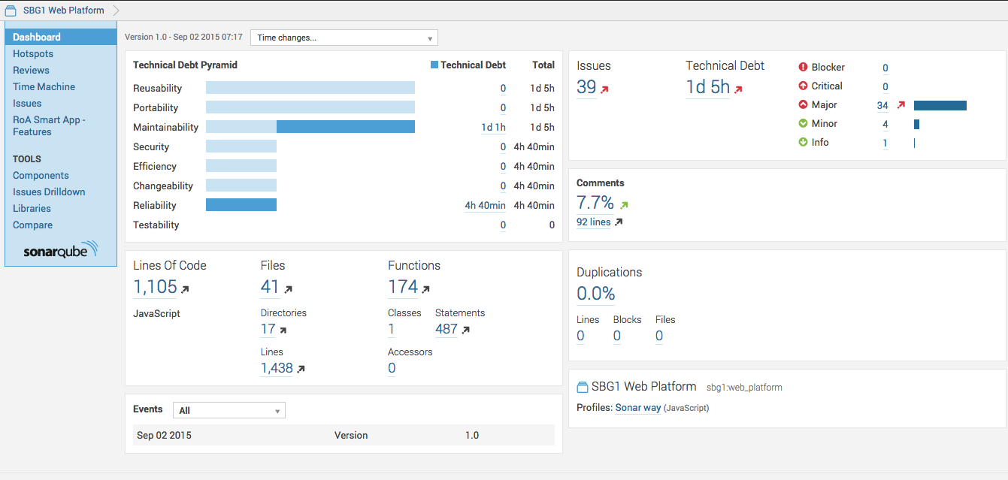

Slide 34
Test Coverage Tools

Slide 35
Why does all of this matter so much?

Slide 36

Uncle Bob
Real name: Robert C Martin
Notes:
Called meeting that lead to the Signing of the Agile Manifesto. Pretty much started agile.
He has video titled The Last Programming Language.
Discipline applied to binary

Slide 37
Everybody in the world that cares about doing anything in the browser will most likely be adding features to JavaScript and those feature will be released every year
Notes:
- https://extensiblewebmanifesto.org/
- I’m not saying JavaScript is going to end other languages or be come the chosen one. But it ain’t going anywhere any time soon.

Slide 38
Event-loop and multi-threading
JavaScript is non-blocking. Allowing the user to still interact with the application while async calls to the back end does it’s things waiting for a call back.

Slide 39
Functions are first class citizens
Delegate the responsibility of executing code to another object while we keep the implementation details hidden.

Slide 40
No servers-side
Well that’s a lie, but there is no application code on the server side
A data base like couchdb that exposes restful api allows you to eassily make use of JSON (Javascript object notation) to contain all the data. You can then write the whole application in the browser and do most of the processing browser side. Along with worker threads and parallelism this is extremly powerful. Javascript will be on the forefront of this, because all browsers support it, it’s open source, TC39 commited to yearly language feature releases and has the biggest user community. Ever written a client-side app? You most probable used javascript then at some point.

Slide 41
Grunt & Gulp
* Tools like grunt & gulp allow you to do really powerful transform on you code. Like removing all the white space or allowing you to write code using the latest version of javascript while you coding and transpiling it into an older version so that there browser can understand. Async await is a good example of this. It’s only in the draft stage for the release for 2016 but you can already safely use it to write code that is more readable and easier to comprehend and it will churn out something more.

Slide 42
References
https://www.w3.org/community/webed/wiki/A_Short_History_of_JavaScript
http://wiki.ecmascript.org/doku.php?id=harmony:harmony
https://developer.mozilla.org/en-US/docs/Web/JavaScript/EventLoop
https://www.youtube.com/watch?v=8aGhZQkoFbQ

